Slide 1
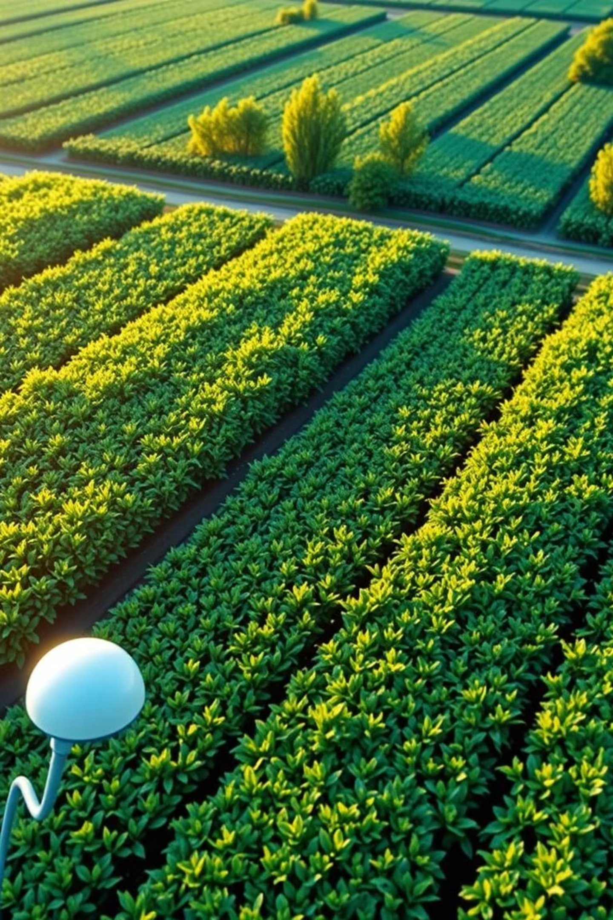


Data-Driven Crop Advisory System
Empowering Farmers with Precision Agriculture

Slide 2
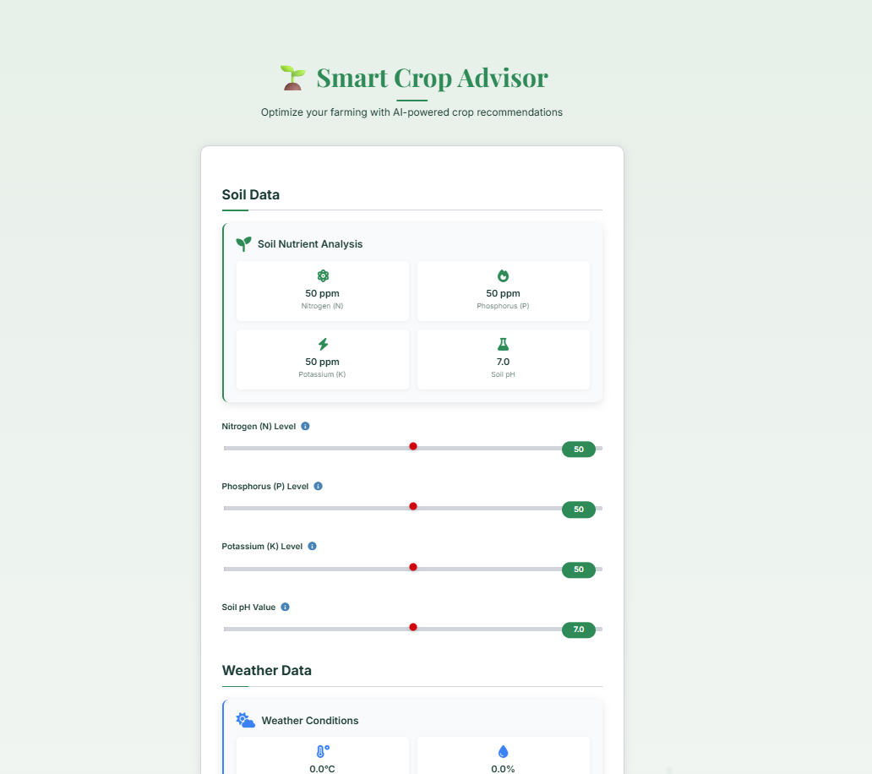
Agenda
The Challenge: Traditional Farming Limitations
Our Solution: Data-Driven Crop Advisory
Key Features and Technology Stack
Addressing the Core Problem
Quantifiable Impact and Benefits
Project Team and Next Steps

Slide 3

The Challenge: Traditional Farming Limitations
Small and marginal farmers often rely on traditional knowledge for crop selection, leading to:
Suboptimal crop yields due to unsuitable choices.
Inefficient resource allocation (water, fertilizers).
Increased input costs and reduced profitability.
Soil degradation from imbalanced nutrient use.
A lack of scientific decision-making tools perpetuates these challenges, hindering agricultural productivity and farmer livelihoods.

Slide 4





Our Solution: Data-Driven Crop Advisory
We are developing a simple, sensor-assisted system that recommends optimal crops and fertilizer advisories based on real-time environmental and soil data. This empowers farmers with precise, scientific guidance for cultivation.
Soil Analysis
Environmental Data
Measures macronutrients (N, P, K) and pH levels to understand soil health.
Integrates temperature, humidity, and rainfall for comprehensive analysis.
Crop Recommendation
Fertilizer Advisory
Utilizes machine learning to suggest the most suitable crop for current conditions.
Provides tailored advice on nutrient application to optimize growth.

Slide 5
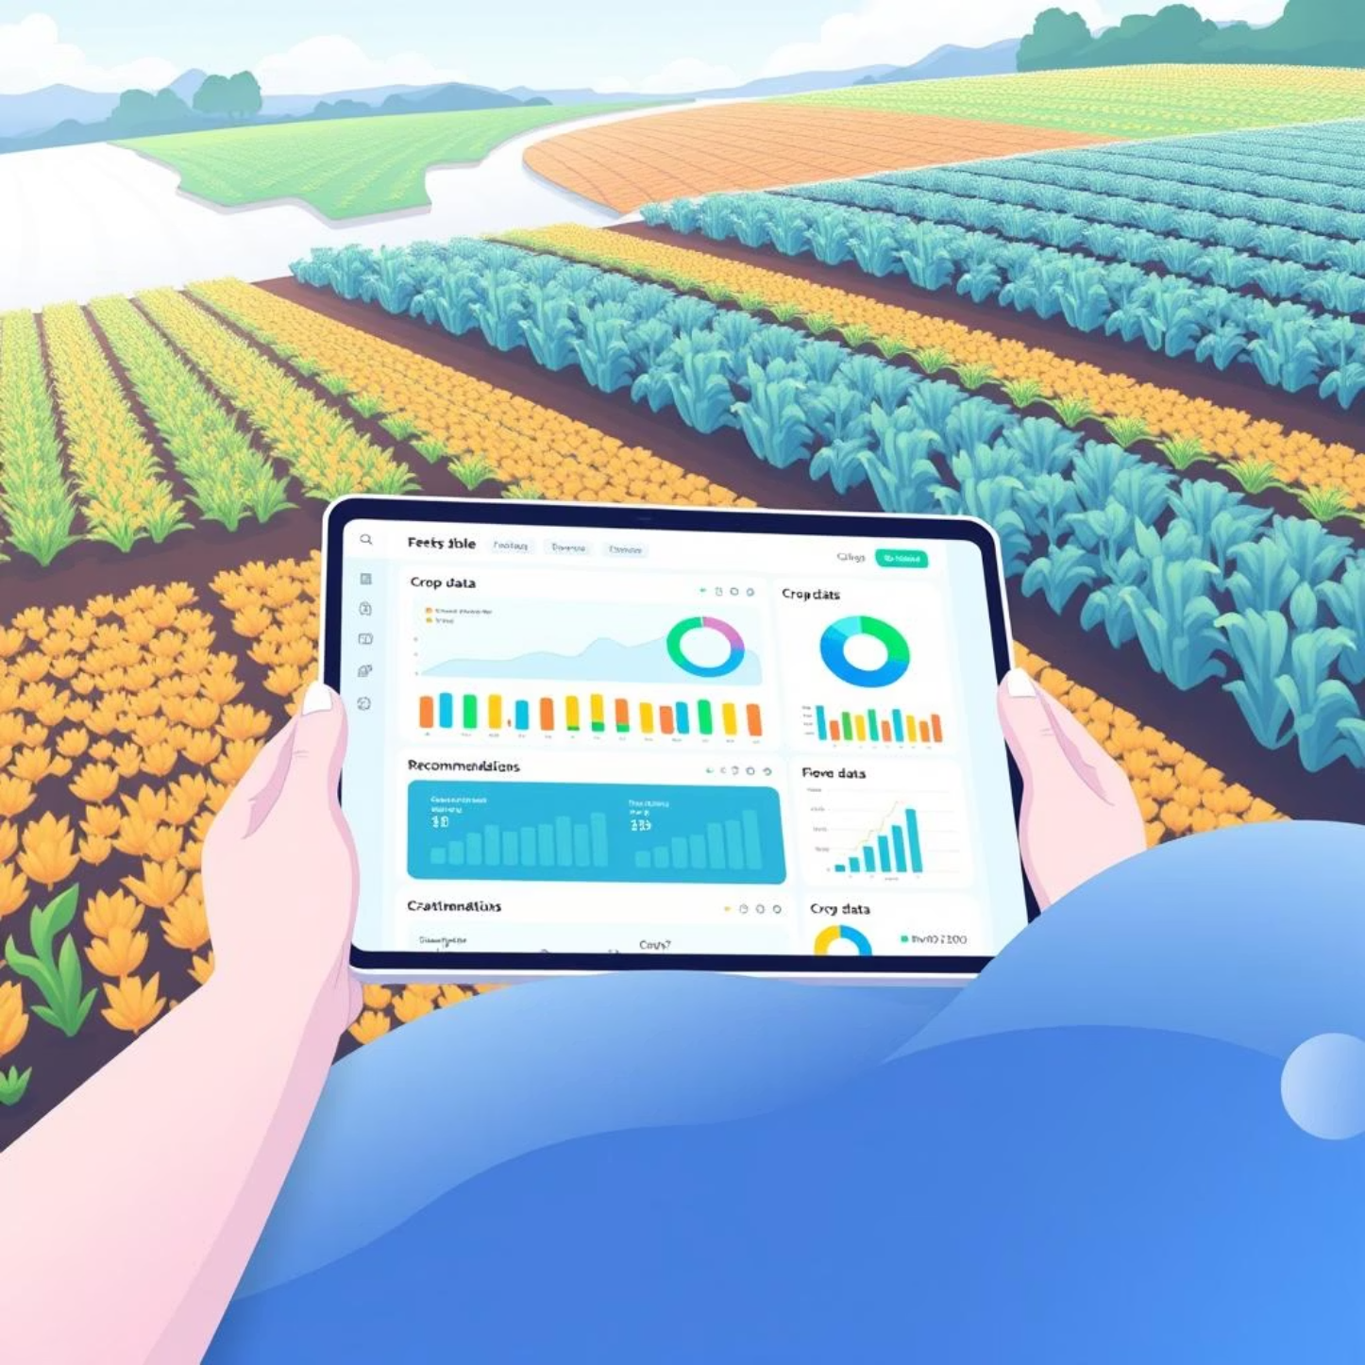

Key Features & Technology Stack
System Features
Intuitive web-based interface for easy access.
Real-time data input and analysis.
Personalized crop and fertilizer suggestions.
Scalable for various farm sizes and crop types.
Accessible on various devices.
Technology Stack
Frontend: HTML, CSS, JavaScript
Backend: Python, Flask
Machine Learning: Scikit-learn (for predictive modeling)
Data Source: Kaggle Crop Recommendation Dataset

Slide 6


Quantifiable Impact and Benefits
Our system promises significant improvements for small and marginal farmers:
20-30%
10-15%
30-50%
Improved
Yield Increase
Cost Reduction
Resource Efficiency
Soil Health
Optimized crop selection leads to higher productivity.
Efficient use of fertilizers and resources lowers expenses.
Minimized water and nutrient waste.
Balanced nutrient application supports long-term fertility.

Slide 7
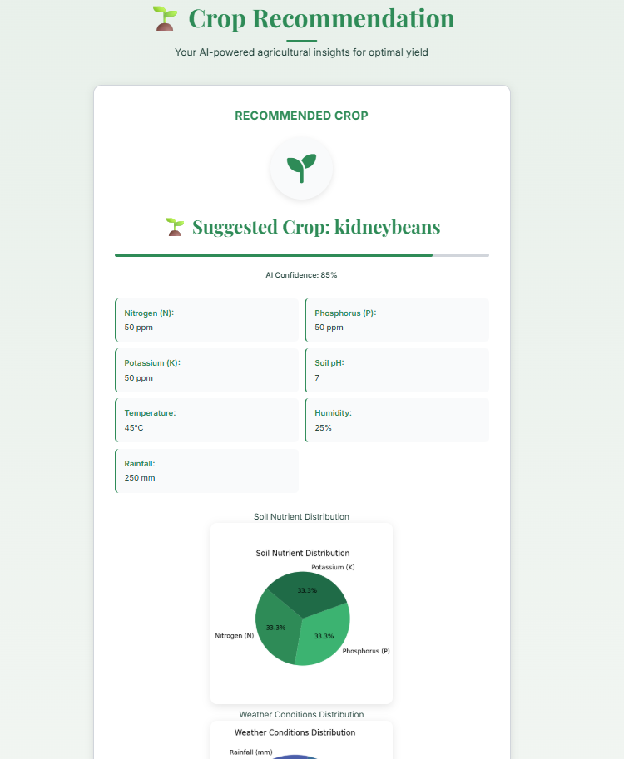
Project Team & Next Steps
Our Team
Pankaj Kumar Mahto : 24CSE394
Hemalata Naram:24BCA070
Jada Leela Prasanth:24ECE113
Thank you for your time and consideration. We look forward to revolutionizing agriculture together.

